Slide 1
Javascript / Backbone training Macy's
Elias Carlston
DevelopIntelligence
elias@eliascarlston.com

Slide 2
Day 3 Schedule
Quick review
Routing
Survey: compare to React
Review / requests

Slide 3
Backbone Routing
Like server-side routing – connects URI to an action
Think gmail: URI can represent one email, search results, edit contact
Backbone router acts on hash fragment or History API
Once page has loaded, call Backbone.history.start()
Mark significant actions with .navigate(fragment, [options])
:params for one section
*splats for multiple
Nest with parentheses
Note slashes count as unique URIs

Slide 4
Lab: Backbone Routing
Hook up routes to an action
Suggested action: dynamically hide / show elements
var Workspace = Backbone.Router.extend({
routes: {
"help/:subject(/:pagenumber)": "help", // .help( subject, [pagenumber] )
"filesearch/*path": "fsHelper", // fsHelper gets passed 'more/than/1/slash/'

Slide 5
React
React is an API to programmatically interact with DOM
React core library is extremely light – only concerned with rendering
( lots of addons available )
Not an MVC: event-driven, one way data flow
Component paradigm: build small chunks & reuse
React.render(
React.createElement( 'h1', { 'initValues': 'get passed as props' }, 'Hello!' ),
document.getElementById('myDiv')
);

Slide 6
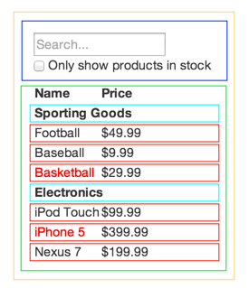
React
Component paradigm
FilterableProductTable (orange): contains the entirety of the example
SearchBar (blue): receives all user input
ProductTable (green): displays and filters the data collection based on user input
ProductCategoryRow (turquoise): displays a heading for each category
ProductRow (red): displays a row for each product

Slide 7
React
JSX
Javascript XML syntax transform
Access API via XML (pseudoHTML) instead of JS
Requires transpiliation during build step
var MyComponent = React.createClass({
render: function(){
return <h1>Hello, world!</h1>;
}
});
ReactDOM.render( <MyComponent/>, document.getElementById('myDiv') );

Slide 8
React
Data model: state and props
State represents values within the current component
Props represents values passed in from parent component
var RealTimeInput = React.createClass({
render: function() {
var message = this.state.message;
return <input type="text" value={message} onChange={this.handleChange} />;
},
handleChange: function(event) {
this.setState({message: event.target.value});
},
getInitialState: function() {
return {message: this.props.message || 'Hello!'};
}
});

